Slide 1
Ecosystems
Year 7 Science

Slide 2
Preview
Science Understanding - Biological sciences Interactions between organisms can be described in terms of food chains and food webs; human activity can affect these interactions. using food chains to show feeding relationships in a habitat constructing and interpreting food webs to show relationships between organisms in an environment classifying organisms of an environment according to their position in a food chain recognising the role of microorganisms within food chains and food webs investigating the effect of human activity on local habitats, such as deforestation, agriculture or the introduction of new species exploring how living things can cause changes to their environment and impact other living things, such as the effect of cane toads
9 | Living and Non-Living Habitats and Interaction Living places and adaptations | Module 5.1 | What Lives in Your School Yard? Pg. 192
10 | More Plant and Animal Adaptations |  |  | Ecosystems Research
T4 Week 1 | Food Chains and Webs | Module 5.2 | Woolly Web pg. 200
2 | Human Impact on Ecosystems | Module 5.3 and 5.4 | Investigating Environmental Impacts pg. 218
3 | Case Studies of Endangered or Extinct Australian Plants or Animals eg. Numbat
4 | Revision |  | Chapter Review pg. 220 | Biology 2 Test

Slide 3
Learning Intentions
Interactions between organisms can be described in terms of food chains and food webs; human activity can affect these interactions.

Slide 4
Success criteria
Define habitat, ecosystem, organism, biotic and abiotic.
Classify features of an ecosystem as biotic or abiotic.

Slide 5
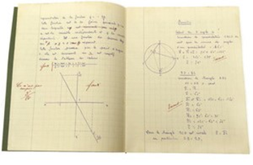
Ecosystems 8/09/2024
An ecosystem is a system that organisms and their environments form through their interactions. The biotic and abiotic components are linked together through nutrient cycles and energy flows.

Slide 6
Activity 1: Design a habitat

Slide 7
Activity 2: Classify features of the habitat

Slide 8
Biotic and abiotic factors
Biotic factors are living features of the ecosystem, such as predators, prey or competition.
Abiotic factors are non-living features of the ecosystem, such as temperature, terrain, light levels or moisture.

Slide 9
Success criteria
Define habitat, ecosystem, organism, biotic and abiotic.
Classify features of an ecosystem as biotic or abiotic.

